Slide 1
Inform: Perinatal Depression Screening 2016 Assessment and Scoping
Jocelyn Audelo, RN MPH
Principal Consultant, CMI Center for Health System Performance

Slide 2
Background
Healthy Beginnings* is a Care Management Institute strategic initiative area that supports inter-regional MCH preventive health improvement efforts.
Healthy Beginnings has engaged in early assessment around perinatal depression this year.
Rationale:
Perinatal depression impacts between 12-20% of pregnant women; we know it may be underdiagnosed and undertreated. Significant negative impacts on maternal and child/family health
ACOG, USPSTF guidelines recommend universal screening; new HEDIS measure on adult depression screening will begin in 2016
Healthy Beginnings Community of Practice and OB Chiefs have recommended perinatal depression as an important area to scope this year based on current internal/external landscape
Proposed activities:
Assess current KP practices in prevention, screening, and referral to treatment for perinatal depression
Identify needs and opportunities for alignment
Develop measurement proposal
*Healthy Beginnings shares its name with the perinatal education program and content but is a different body of work.
See appendix for current areas of focus and high level initiative drivers

Slide 3
Perinatal Depression Screening Internal Scan Initial findings
Six of eight regions will be using PHQ-9 by end of year (with or without GAD-7 or GAD-2). Two regions use EPDS.
All regions meet the high-level AHRQ, USPSTF, and ACOG recommendations re: screening for depression in pregnancy and postpartum but may not meet current AAP Bright Futures recommendations to incorporate recognition and referral for parental depression risk in pediatric settings.
Behavioral health resources or changes in access/capacity may be impacting providers’ perceptions around care options and associated screening or referral practices.
Few regions are currently reporting data to examine performance (i.e. screening rates, referral data, symptom improvement, BH services utilization for this population, etc.)

Slide 4
Perinatal Screening – Tools and Timing*
*Planned additions in italic.
**Does not include single-item screening questions
Region | Instrument in use | First trimester | Second trimester | Third trimester | Pediatric well visits** ( in first year of life) | Postpartum visit (5-8 weeks) | Other
Georgia | Edinburgh | First OB visit | - | 28 weeks | - | X | -
Hawaii | PHQ-9 (plus two IPV questions) | - | - | 28 weeks | - | X | -
Northwest | PHQ-9 with GAD-7 | - | 20-24 weeks | - | - | X | -
Colorado | Edinburgh; will be changing to PHQ-9 with GAD-7 in the next year | First OB visit | - | X | PHQ-2 at 2 month visit 2 month visit 4 month visit Dad/partner @ 2 wk visit | X | Parents of infants in the NICU
Southern California | Varies by site (PHQ-9 and/or Edinburgh) | First OB visit | - | - | - | X | -
Northern California | PHQ-9 | First OB visit | 24-28 weeks |  | PHQ2 at 2-4 weeks, 2 month, 4 month, 6 month, 9 month | X | -
Group Health | PHQ-9 | First OB visit | - | - | - | X | -
Mid-Atlantic States | PHQQ-9 with GAD-7 | First OB visit | - | - | - | X | -
Notes:
Prenatal and Postpartum Care · Timeliness of Prenatal Care 93.28% 93.10% 95.57% 91.73% 88.00% 96.46% 96.59% 97.48% 94.65% 97.50% · Postpartum Care 73.95% 79.31% 67.72% 77.13% 86.00% 93.20% 93.43% 90.57% 91.48% 93.33%

Slide 5
Potential opportunities
Understand current regional performance through initial measurement of screening practices
Consider consistent screening approaches (frequency, timing)
Explore how to optimize postpartum visit attendance and/or use screening touch points outside of postpartum visit in the first year after birth
For example, 2015 HEDIS postpartum visit rate ranges from 67.7%-93.4%; women at higher risk for postpartum depression may be less likely to attend a postpartum visit
An approach that allows for identification of late-onset postpartum depression may need to screen beyond the postpartum visit timeframe (around 6-8 weeks)
Several regions have tested screening using digital tools (i.e. secure messaging, kp.org) among adults, but not specific to perinatal timeframe
Examine workflows across pediatrics (specific to parent identification), behavioral health, OB and family medicine where patients receive care and may transition across departments frequently, in context of broader inter-regional depression care management focus area
Explore evidence-based perinatal depression prevention strategies (i.e. peer networks, etc.)
Based on the opportunities above, leverage decision support for reliable screening and referral as well as resource use practices

Slide 6
Proposed next steps
Further study current regional practices to understand variation in other aspects of perinatal depression programs (education and prevention, pathways for referral and treatment/follow-up, coping and self-management).
Scan the external landscape for screening and treatment practices for perinatal depression
Scope/pilot perinatal depression screening metric(s) to support shared opportunities

Slide 7
Maternal Depression Screening Metrics

Slide 8
Metrics for Maternal Depression Screening Draft Metric Overview
Population
Members with a live birth during the calendar quarter
Metrics:
Prenatal Screening: Screened at least once during the 9 month period prior to delivery
Postpartum Screening: Screened at least once during the 3 month period after delivery
Notes: Screening must be in KPHC as discrete data, using either PHQ-9 or Edinburgh
Pilot Testing
Will test in 1-2 regions through September, then additional regions
Testing will assess feasibility, data access, and sensitivity of specifications to screening tools and timing

Slide 9
Metrics for Maternal Depression Screening
Open Questions for Metrics
What are we solving for? Not screened at all, not screened at the right time, or not screened frequently enough?
Are metrics for one screening prenatal, and one postpartum, the right place to start?
Pilot Testing Questions
What are screening rates, variation, and room for improvement?
When does screening take place during prenatal and postpartum periods?
Which tool is used for screening?

Slide 10
Discussion
Do you support our continued work (the proposed next steps)?
Are there opportunities that should be added to the list? Removed?

Slide 11
Appendix

Slide 12
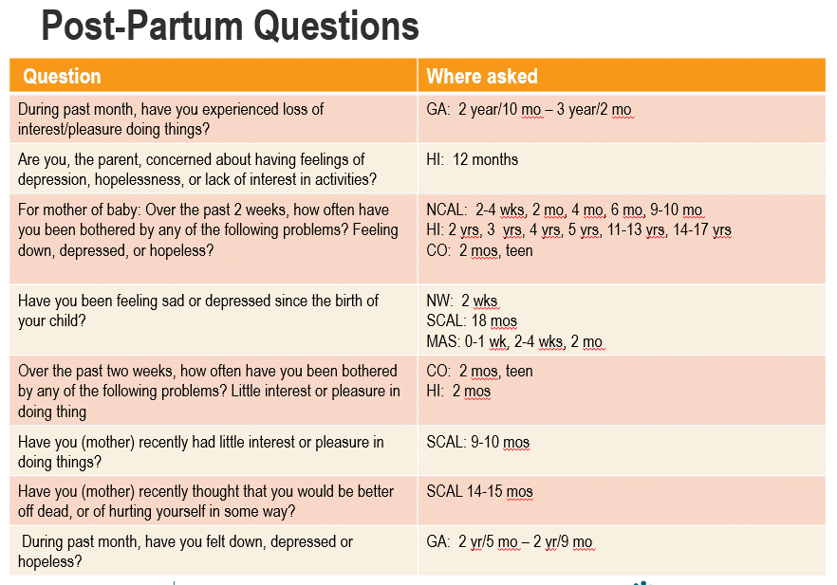
Some maternal/parental depression questions are also included on pediatric well visit questionnaires

Slide 13
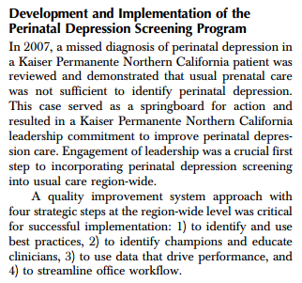
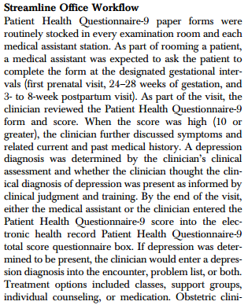
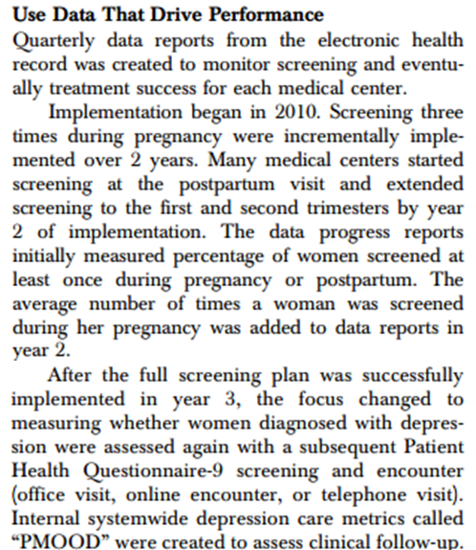
Publication - NCAL Approach

Slide 14
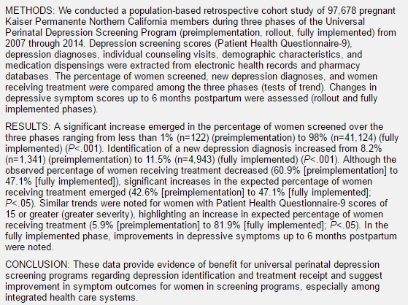
Publication - NCAL Results

Slide 15
1
Preconception health (i.e.. healthy weight at time of conception)
Pre-pregnancy BMI
2
Address substance use/abuse and behavioral health in pregnancy
Perinatal depression screening
3
Gain healthy amount of weight during pregnancy; postpartum weight management
% Gaining per IOM recommendations
Promote total health among women of childbearing age & children aged 0-5* in KP members, workforce, & communities for optimal development & wellbeing for families across the lifecourse
4
Tobacco cessation before/during pregnancy
Pre-pregnancy and intra-pregnancy quit rates
5
Reduce risks among pregnant women with elevated cardiometabolic risk (i.e.. GDM)
GDM prevalence, postpartum testing rates, infants born large for gestational age, DM progression.
6
Breastfeed exclusively for 6 mo; continuing through 1+ year
BF exclusivity and persistence
7
Establish patterns of healthy eating and active living for child and family
2-5yr old BMI trajectory
Introduction of solid foods <4-6 months
WFL percentile crossing during infancy
8
Address food insecurity and social factors that contribute to chronic disease risk
TBD – Food insecurity screening;
Bold = Existing measures
Red = Under development
Gray = TBD/proposed
9
Support parental resilience and promote healthy brain development for children
Talk/Read/Sing, Health Leads Evaluations
ACEs pathway (?)
Notes:
Key points:
The HB driver diagram was developed in conjunction with the HB clinical and operational leaders across peds and OB who comprise the inter-regional community of practice
The primary drivers and measurement strategy span the preconception timeframe through childhood and include:
Preconception health
Substance use and behavioral health
Pregnancy weight management
Tobacco
High risk pregnancies such as GDM
Breastfeeding
Nutrition and physical activity in young children
Social determinants of health for growing families
Promoting healthy parenting and brain development
One unique thing to highlight about the drivers in the HB work is agreement about these drivers as shared preventive health priorities across OB and pediatrics – clinical focus with strong ties to how KP moves in communities and as an employer
At the direction of the CoP and the MPE leaders, the HB team supports focused improvement work in collaborative subgroups to address specific topics. (Examples: breastfeeding, weight management, GDM).
The team also supports assessment in newer areas of IR focus (i.e. perinatal depression) and coordination of evaluation and sharing from local demonstration work such as the “Talking is Teaching -“Talk, Read, Sing” pilot.

Slide 16
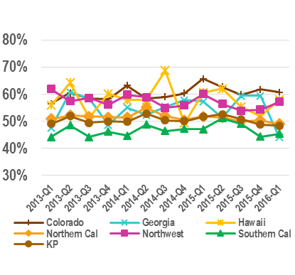
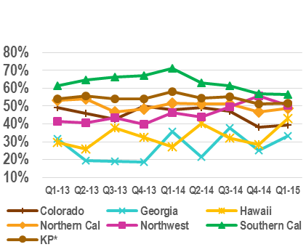
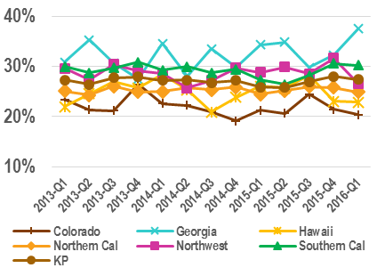


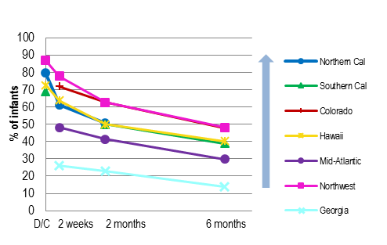
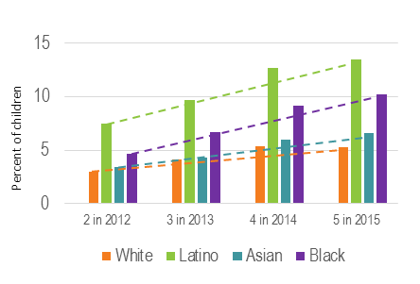

Percent of women with live births who started pregnancy in obese BMI range (>30)
Percent of Women who Gained Above IOM Guidelines During Pregnancy By BMI -- Overweight: BMI 25-29
Percent of women who had GDM in pregnancy completing any recommended follow-up test within 12 mo postpartum
Percent of KP infants exclusively breastfed at hospital discharge through 6 months of age; Q4 2015
Percent of children in BMI category “very obese”, by race/ethnicity, from age 2-5
A perinatal depression metric is currently in assessment/scoping phase
Current as of Q1 2016
Potential areas for future development: Vulnerable populations, behavioral health, substance use/abuse and intervention program reach/uptake, social/economic/behavior needs, ACEs, community or workforce level metrics
Notes:
Key points:
Underpinning of the HB strategy is using measurement to understand opportunities and track progress in solving problems
Each measure on the high level dashboard has a more granular report that goes along with it, used by HB subgroups and the overall CoP to better understand the problems and look for alignment opportunities
Some of these measures are a part of KPQM via the total health and maternity/perinatal dashboard

Slide 17
CMI Healthy Beginnings Initiative: 2016 focus and activities
Monitor performance, support collaboration
Assess current state - scope shared work
Breastfeeding (including disparities focus; co-design)
Pregnancy weight management
Perinatal depression
Addressing Adverse Childhood Experiences (ACEs)
Develop, evaluate, and spread innovations
Talk, Read, Sing pilot
Well child visit design (linked with social needs, screening tools, etc.)
Gestational Diabetes – advisory group (follow-up care)
Established focus area – drive the effort

